Slide 1
Tavern Table
Group 7
Notes:
Jon - Intro

Slide 2
Members
Jonathan White
Sarah Thompson
Susan Long
Imahd Khan
Arisa Kitagishi
Fernando Bilbao
John Balbuza
Notes:
All :-)

Slide 3
What is our project?
'Tavern Table'
Dungeons and Dragons (DnD) App
Can be a Dungeon Master or a player on a game-by-game basis
Tracks character statistics, equipment, and abilities
Maintains Character Sheets Publicly
Notes:
Sarah

Slide 4
Technology
MobaXTerm
phpMyAdmin
Android Studio
Inkscape
Advanced R.E.S.T. Client
Amazon Web Services

Slide 5
… And Git.
Both a blessing and a curse
Most of the team was unfamiliar with git
Biggest obstacle was merge conflicts
Although frustrating, led the group to better understand each other's process
Worked together to learn the new software
Another challenge was keeping track of progress
Other members could be working with a previous version of your module
Solution: frequent integration testing to keep team members up to date

Slide 6
Firebase
Real time database
NoSQL (non-relational) structure
Used to power chat system
Each new campaign creates a table
The table's children are the chat messages
Key-value structure
Anytime the table is updated, any android activity connected to the real-time database is updated

Slide 7
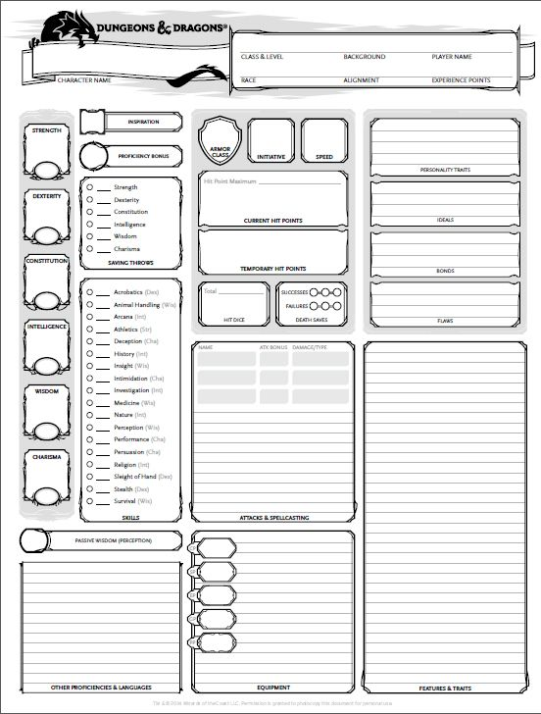
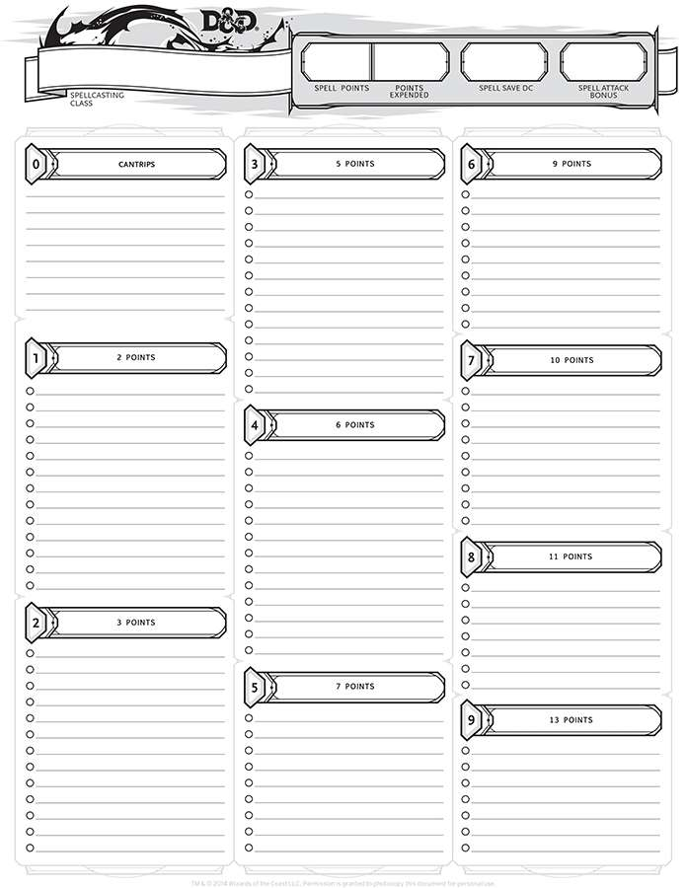
Notes:
Susan

Slide 8
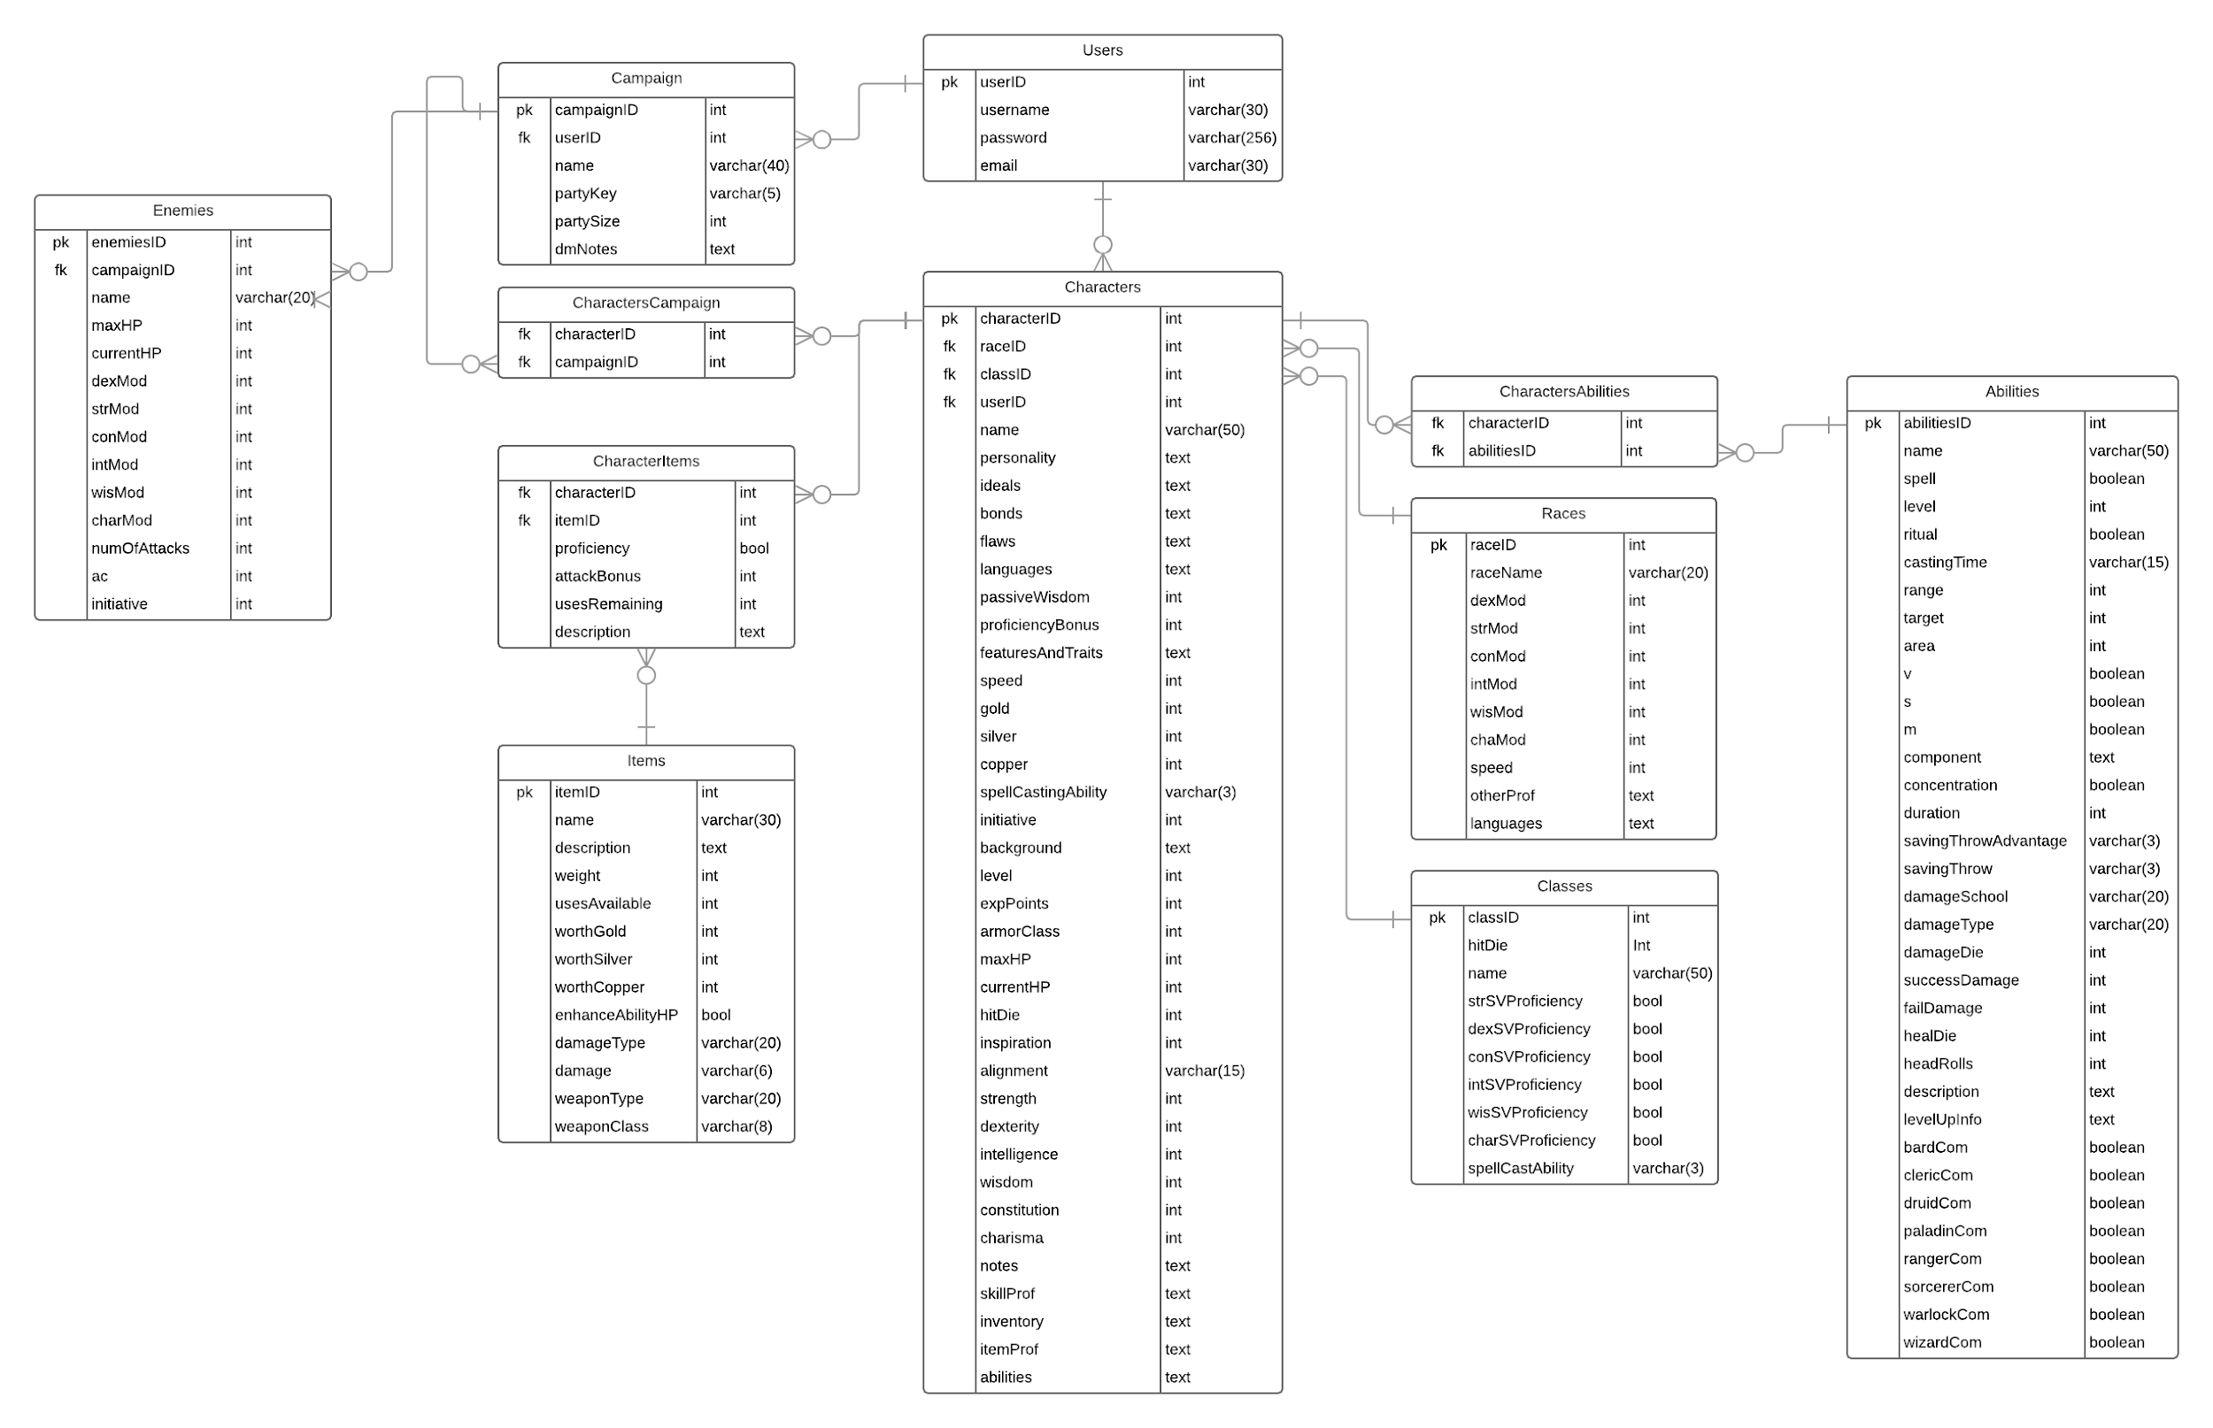
ERD
Notes:
John: Talk about the multiple iterations of the database. -- How it has changed through the course of the project. Kept character campaign, dropped multiple tables to simplify implementation.
Jon: Friend System implementation

Slide 9
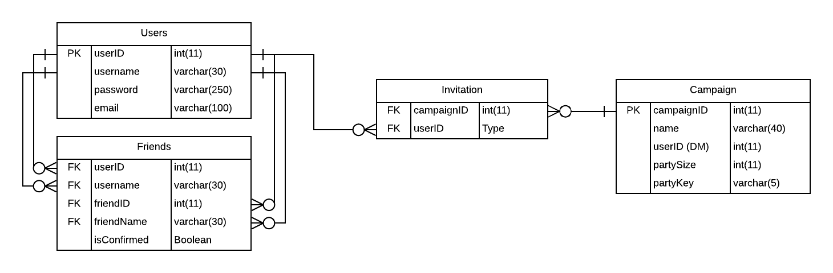
Friends Diagram

Slide 10
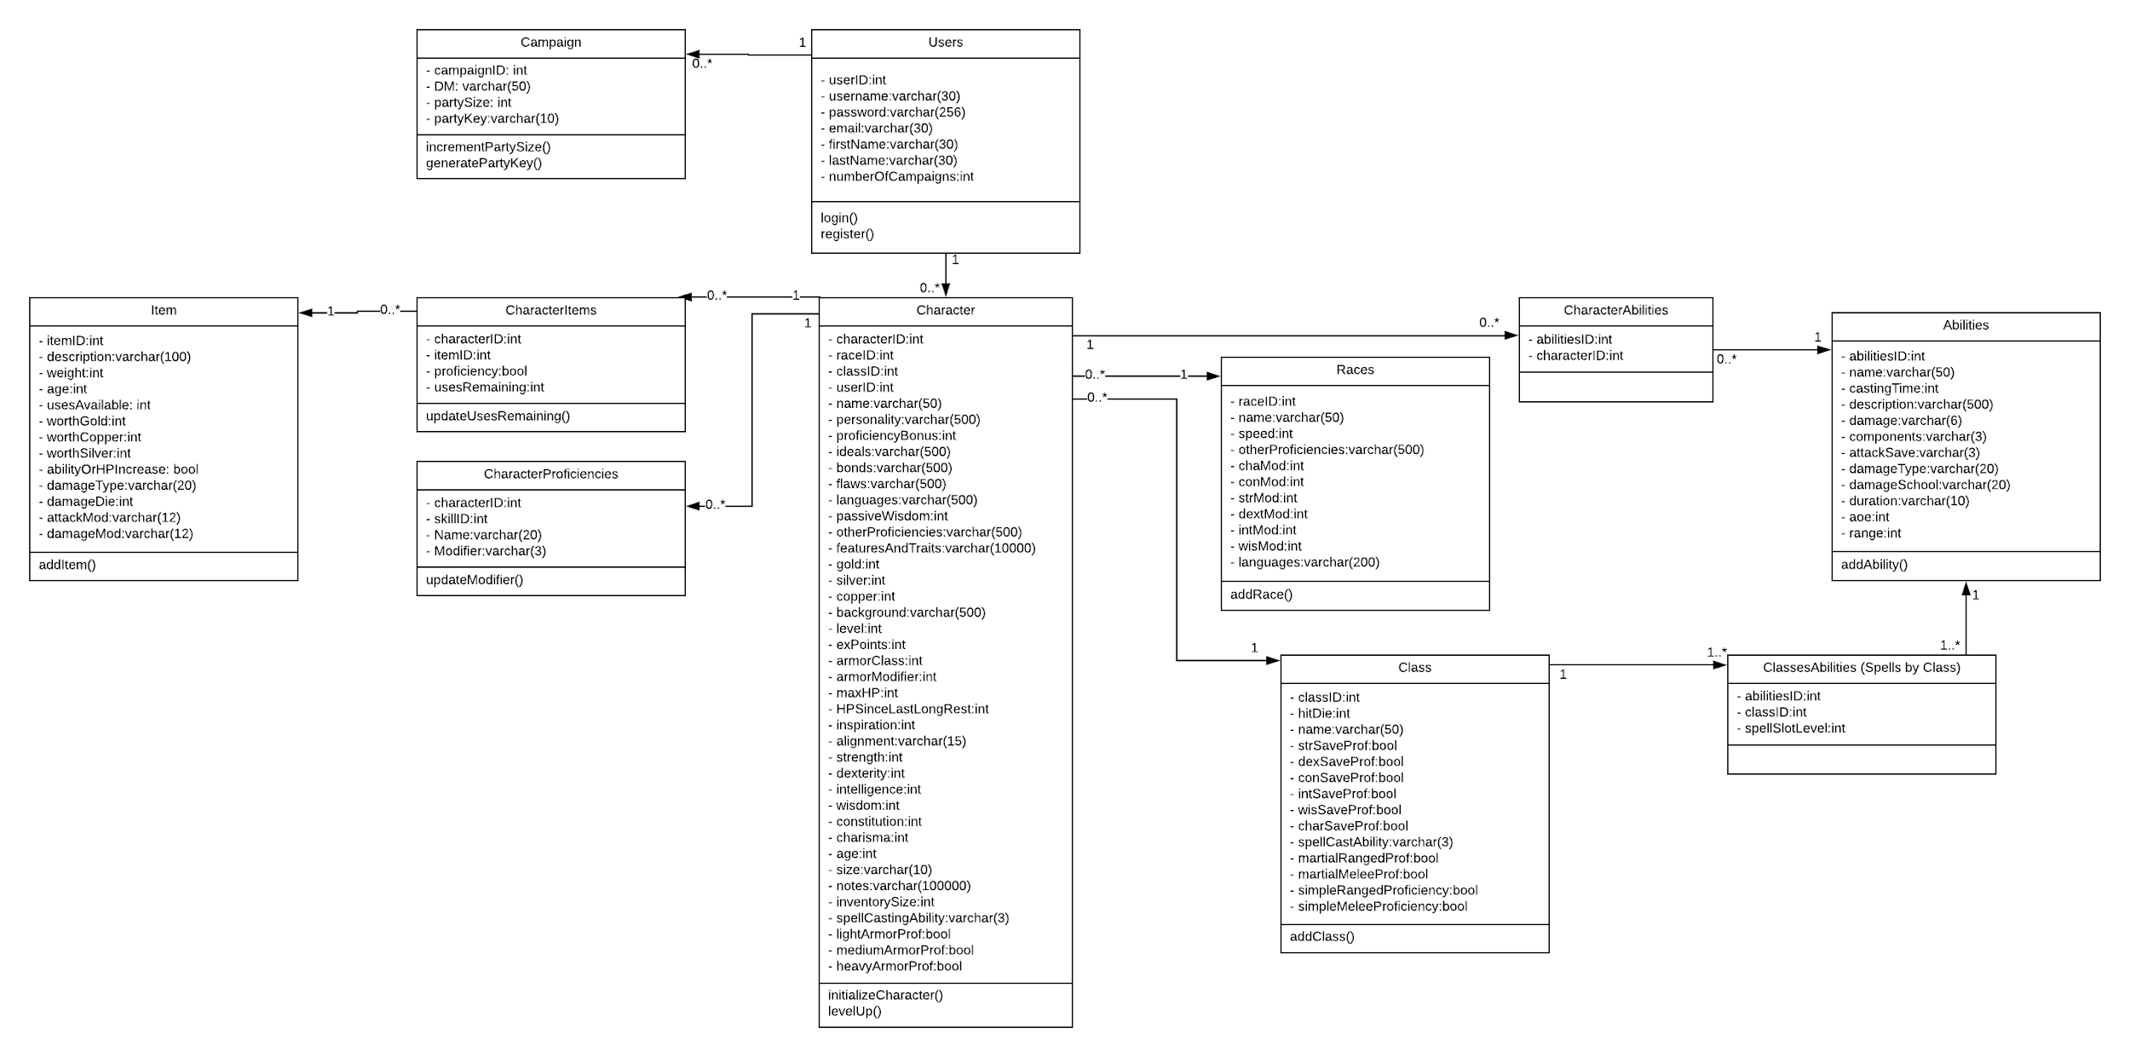
Class Diagram
Notes:
John

Slide 11
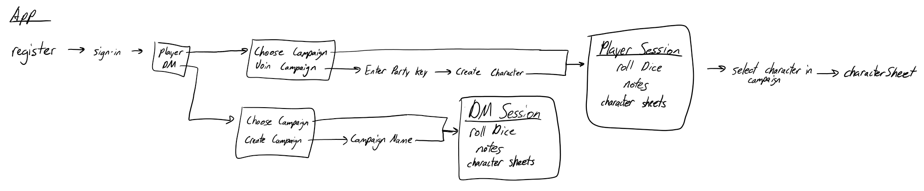

Slide 12
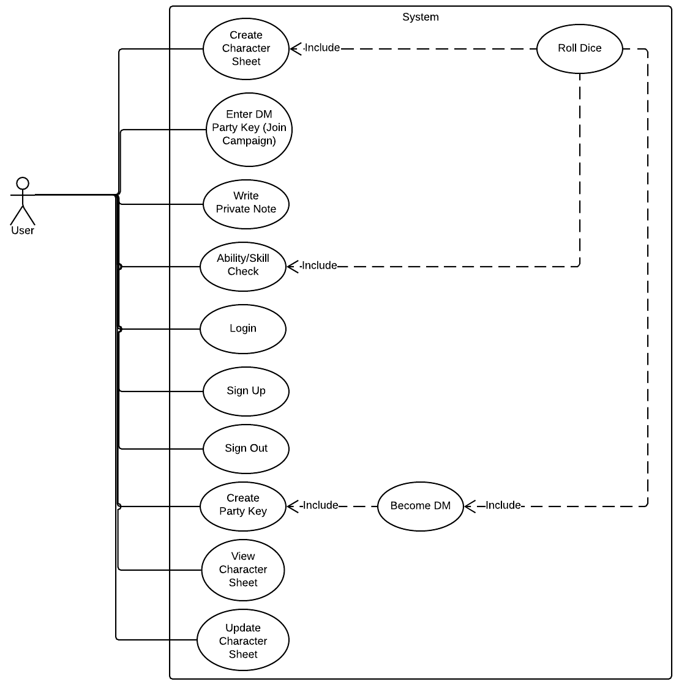
Use Case
Notes:
Susan

Slide 13
The Plans
Organized the project into phases
Phase 1: User Interface
Phase 2: Functionality
Phase 3: Networking
Battle System
Automated Dice Comparisons
Level Up

Slide 14
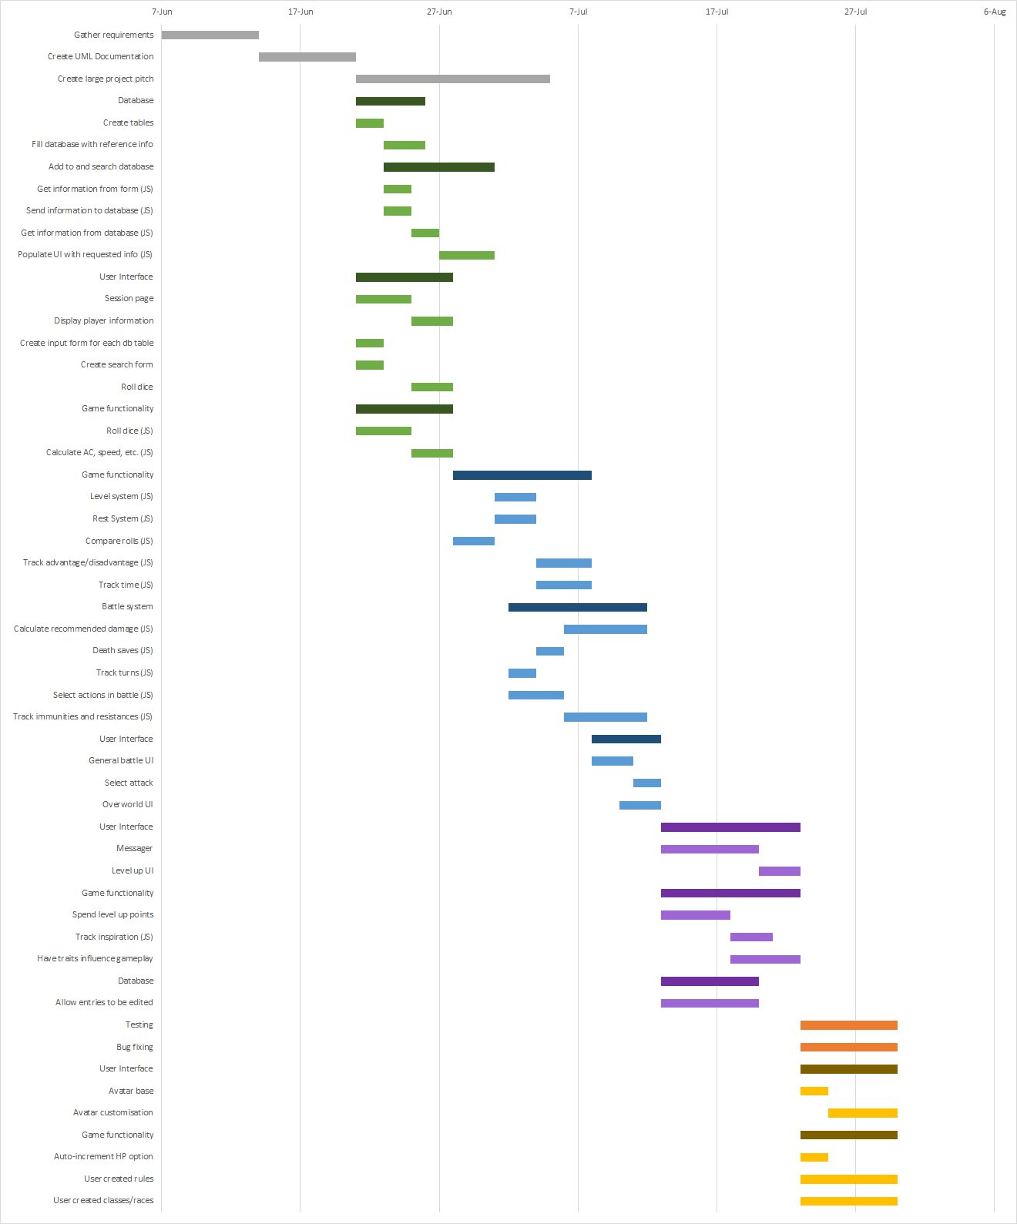
Gantt Chart
Notes:
Jon

Slide 15
Gantt Chart
Notes:
Jon

Slide 16
Gantt Chart
Notes:
Jon

Slide 17
The Actuality
Many modules required work from all three phases before they could be tested
Rigorous division meant we often had to revisit activities
Gantt chart become more of a task tracking tool than a schedule

Slide 18
Demonstration
Account ID: 131
Party Key: 6tr4u

